Slide 1

HTML, CSS & JavaScript

Slide 2
Introduction
The web pages you visit every day are based on three core technologies, HTML, CSS, and JavaScript.
Together, they enable you to create web pages and applications so you can offer any content you have seen online.
In this lecture, I will demonstrate two examples you can create using these technologies.

Slide 3
Introduction
This is to help you understand how they interact with one another.
In the first example, I'm building a web page that displays a digital clock.
It shows the hour, minutes, and seconds.

Slide 4
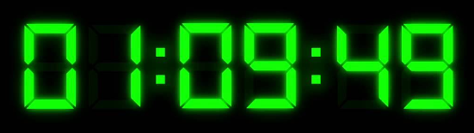
Example 1: Digital Clock Page
The time is updated every second.
I will work with three files,
  an HTML,
  a CSS, and
  a JavaScript
file and you will explore the purpose of each one of them.

Slide 5
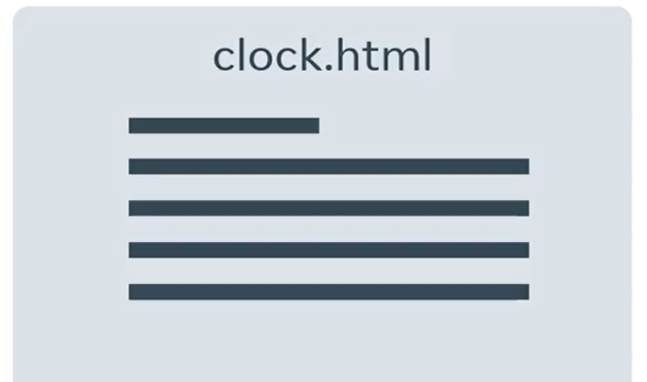
Example 1: Digital Clock Page
To create the clock element, Let's first define our HTML code in a file called clock.html.
The HTML code has an element
that describes the content in hours,
minutes, and seconds.

Slide 6
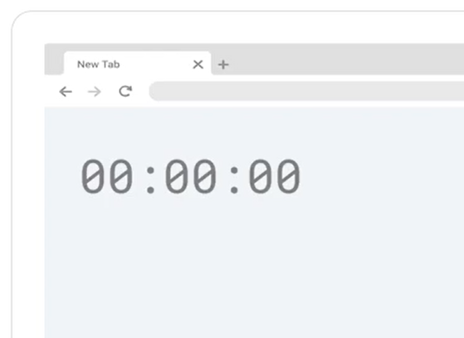
Example 1: Digital Clock Page
If I only use the HTML file, the content would be shown without any style positioning or sizing, just simply as a display of six zeros representing time in the format of
hours : minutes : seconds.

Slide 7
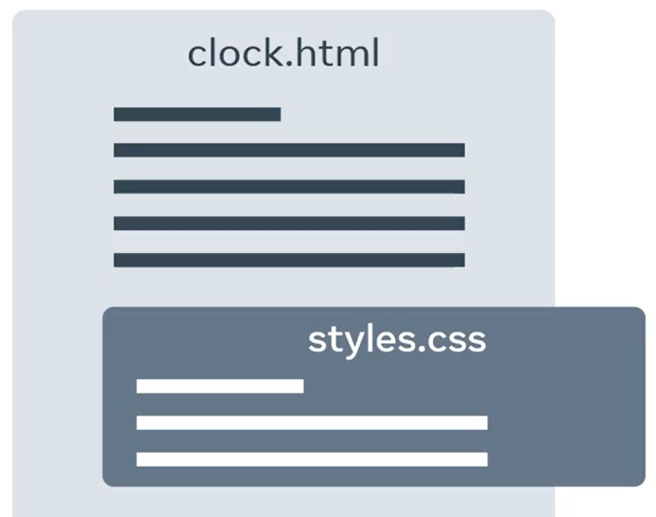
Example 1: Digital Clock Page
To apply styles to the HTML element, the HTML code references a CSS file called styles.css.
The web browser retrieves the styles.css
file and processes it.

Slide 8
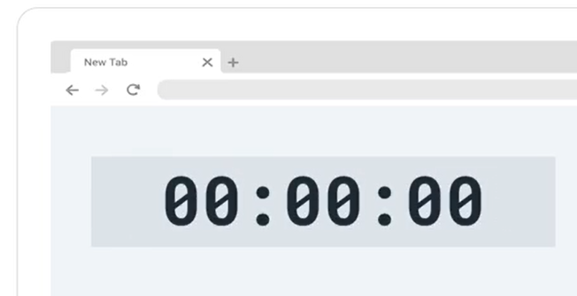
Example 1: Digital Clock Page
The CSS code provides styling for the clock.
It tells the browser the position, size, color, background, and font type, and size of each element on the screen.
With that information, the browser updates the content and the sequence of zeros and colons now display a
digital clock.

Slide 9
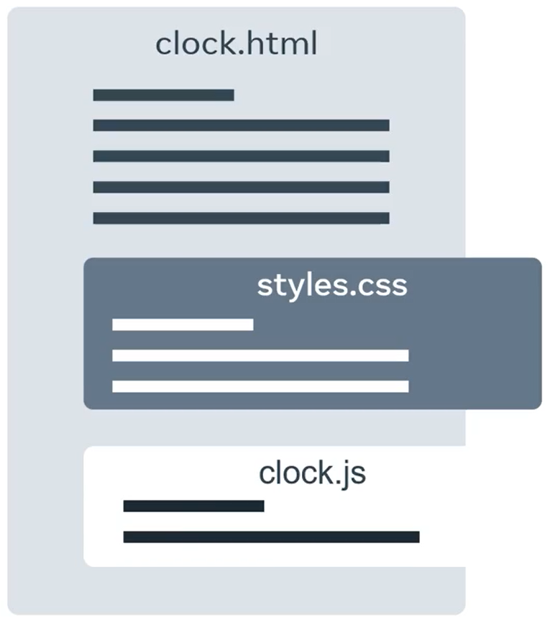
Example 1: Digital Clock Page
Finally, we need to ensure the clock updates with the correct time.
This is where JavaScript comes in.
The HTML references a JavaScript file called clock.js.
The browser will retrieveclock.js and process it.

Slide 10
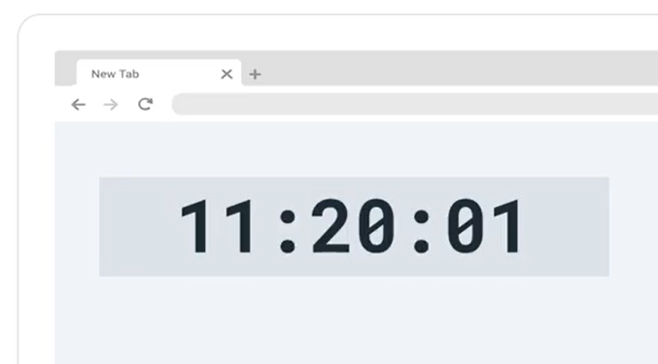
Example 1: Digital Clock Page
The JavaScript file contains code that every second updates the content of the hour, minute, and second elements.
With the three files created and linked together, your clock is fully functional.
The clock example demonstrates JavaScript
dynamically updating content.

Slide 11
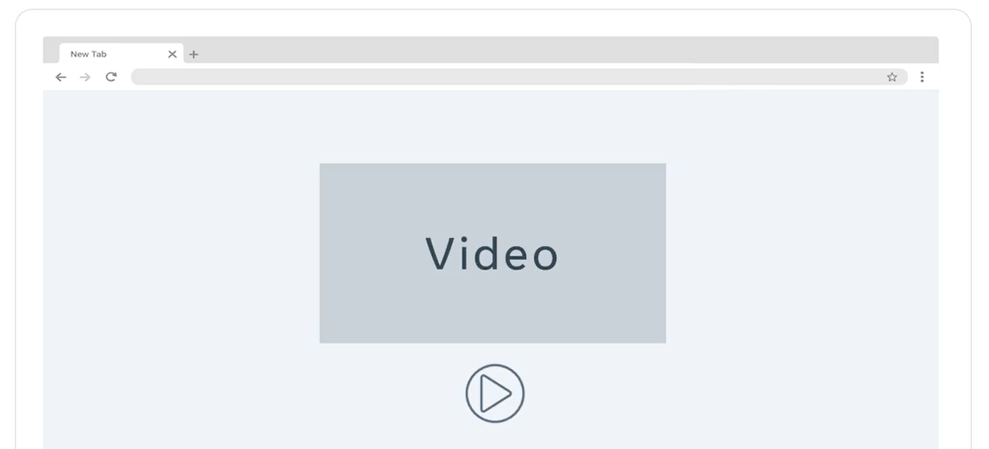
Example 2: Video Playing
JavaScript can also be used for interaction.
The next example demonstrates how JavaScript can be used interactively.
It's a web page that plays a video.
Below the video, there is a button that plays or pauses the video.
The button contains a play icon.

Slide 12
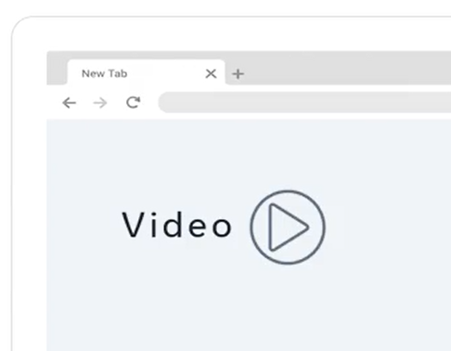
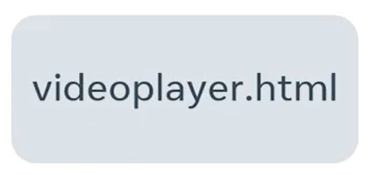
Example 2: Video Playing
My HTML page describes the content, which is the video element and the Play button element.

Slide 13
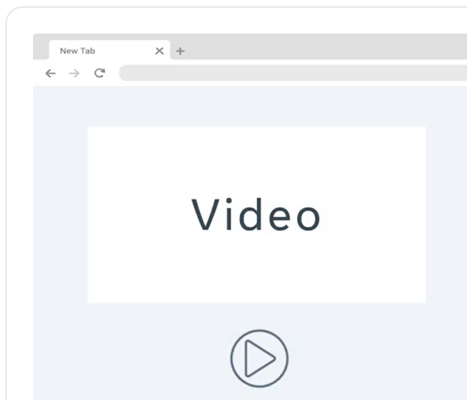
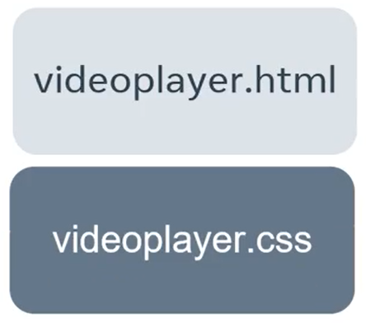
Example 2: Video Playing
The HTML code references a CSS file that the browser retrieves.
It applies the styling to the video and button.

Slide 14
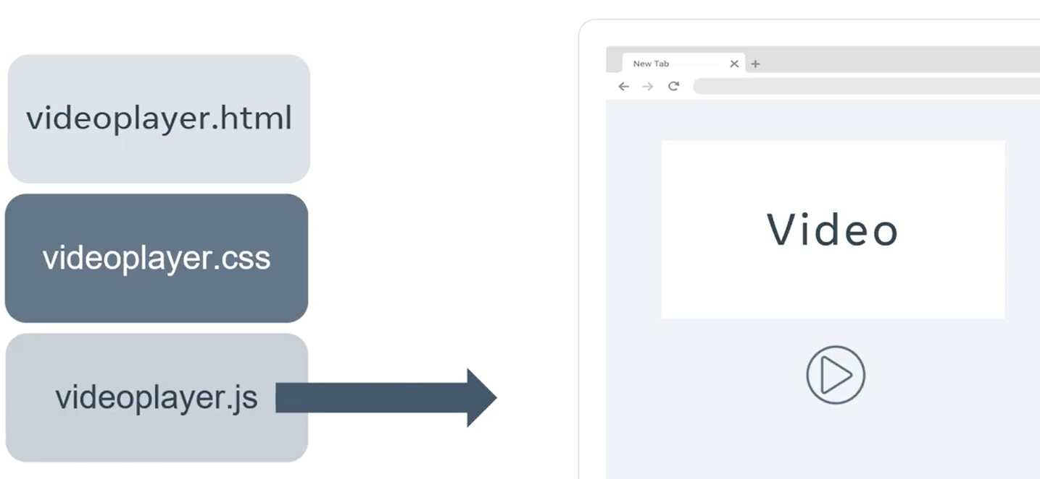
Example 2: Video Playing
The code in the HTML file also references a JavaScript file.
The browser will retrieve the videoplayer.js file and process it.

Slide 15
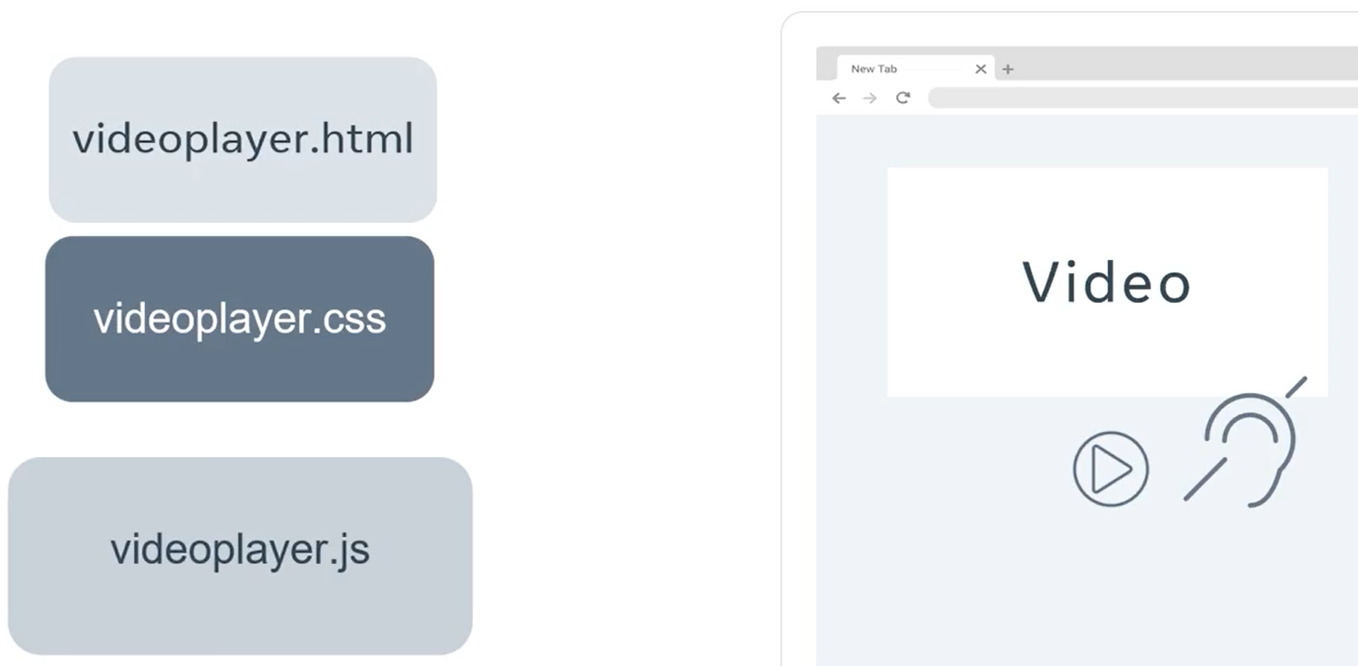
Example 2: Video Playing
In our example, the code in the JavaScript file performs four actions.
1. Firstly, it registers a listener on the button that will execute some code when the button is clicked.

Slide 16
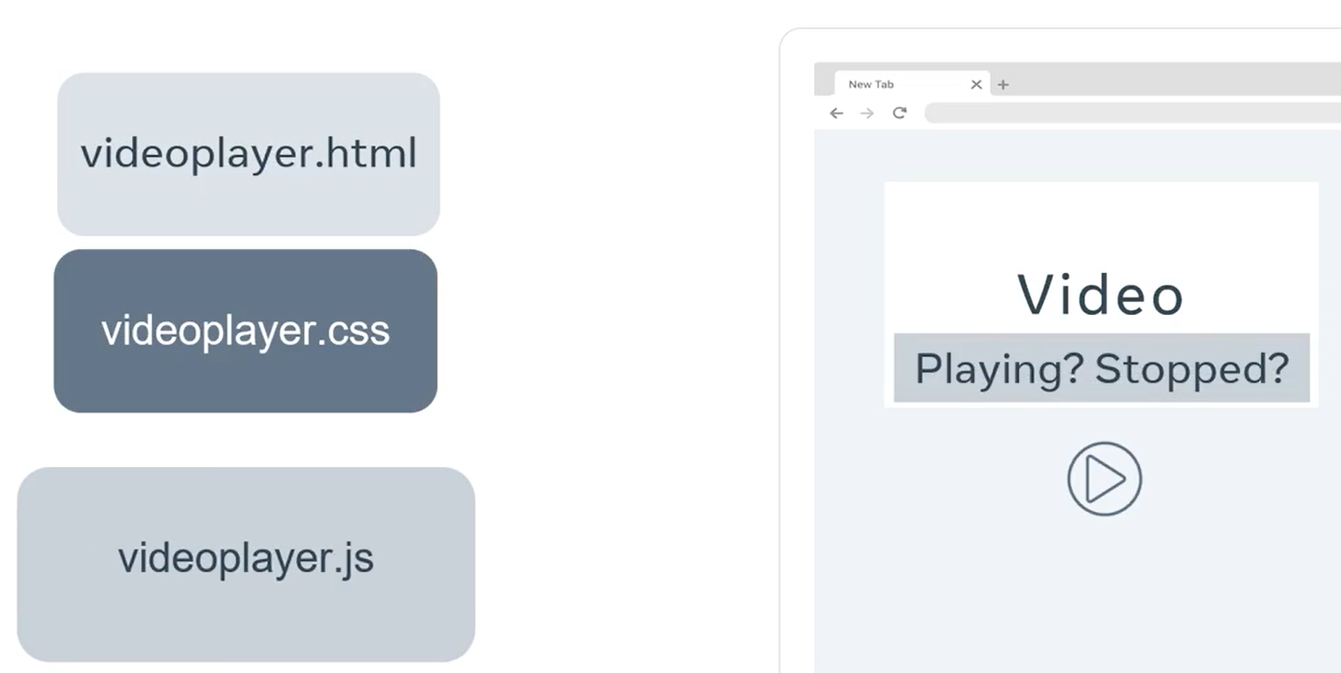
Example 2: Video Playing
2. The second function is that when the code runs, it checks the current state of the video.

Slide 17
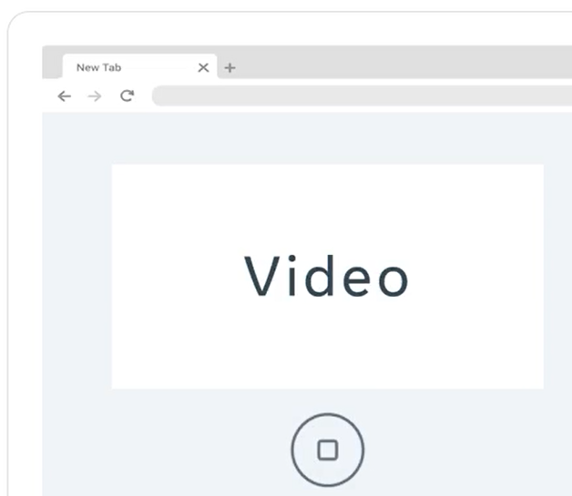
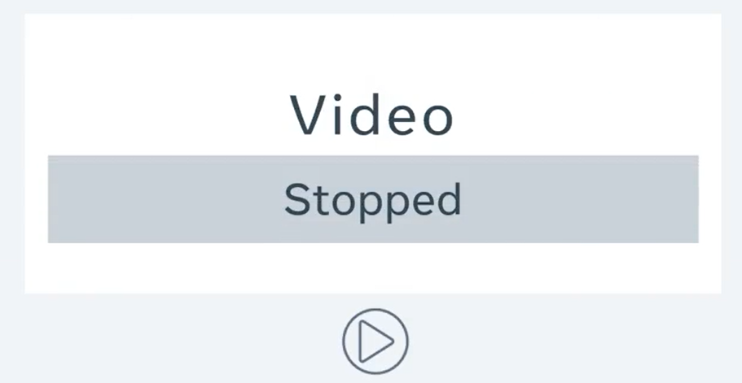
Example 2: Video Playing
3. The result of that check is, if the video is currently stopped,
it begins playing the video and changes the buttons icon to a stop icon.

Slide 18
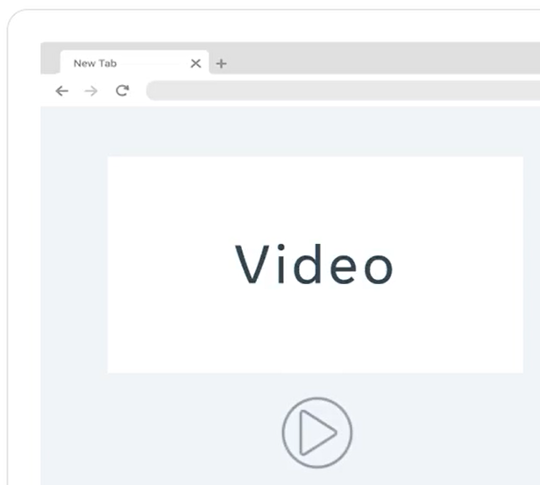
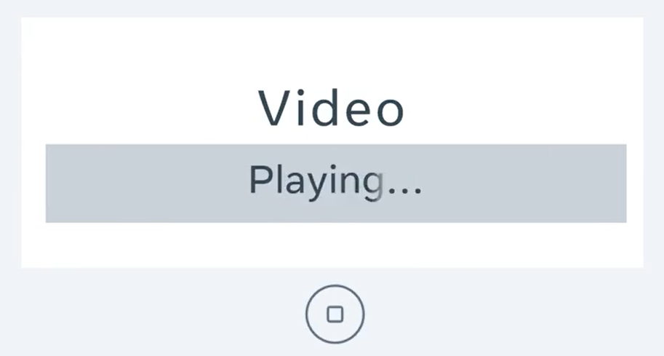
Example 2: Video Playing
4. Or if the video is currently playing, it stops playing the video
and changes the buttons icon to a play icon.

Slide 19
Example 2: Video Playing
Using the three files you create a fully interactive video player.
I hope those examples give you an idea of how the three core files link and work together.

Slide 20
Summary
In both the clock and video examples the HTML file references the CSS and the JavaScript files.
The CSS file is called on to format and style your application, and the code in the JavaScript file implements the core functions of the app and user interactivity.

Slide 21
Additional Resources
Learn more Here is a list of resources that may be helpful as you continue your learning journey.
HTTP Overview (Mozilla)
https://developer.mozilla.org/en-US/docs/Web/HTTP/Overview
Introduction to Networking by Dr.Charles R Severance
https://www.amazon.com/Introduction-Networking-How-Internet-Works/dp/1511654945/
Chrome Developer Tools Overview (Google)
https://developer.chrome.com/docs/devtools/overview/
Firefox Developer Tools User Docs (Mozilla)
https://firefox-source-docs.mozilla.org/devtools-user/index.html
Getting Started with Visual Studio Code (Microsoft)
https://code.visualstudio.com/docs

Slide 22
Thank You

